Slide 1
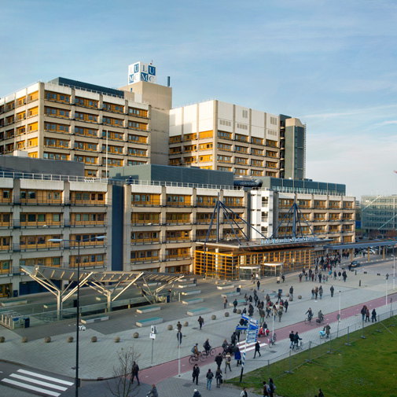
Finding functional relevant genes
Yolande F. M. Ramos
y.f.m.ramos@lumc.nl
Molecular Epidemiology
Leiden, the Netherlands

Slide 2
AIMS of this lecture
Understanding genomic variation, SNPs
Functional relevant variation
Use of online databases

Slide 3
AIMS of this lecture
Understanding genomic variation, SNPs
Functional relevant variation
Use of online databases

Slide 4
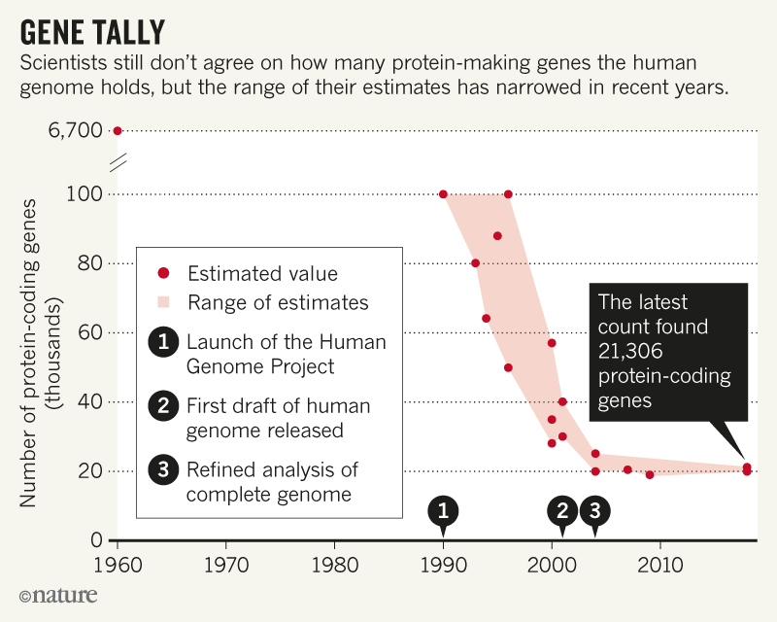

Human Genome
Consists of ~3.3 billion basepairs
Total ~20,000 protein-coding genes
Willyard 2018; Pertea et al 2018, doi: http://dx.doi.org/10.1101/332825
Notes:
Human genome consists in over 3 billion basepairs. Despite the fact that we are all different, we share about 99.5% of the genome and less then 0.5% various among us!
The human transcriptome estimates have been shrinking since its discovery and still discussion ongoing. Humans have approximately 20,000 protein-coding genes (less than 3% of the genome) and many more regulatory regions -> determine where lies origin of heterogeneous disease such as OA?!
Which genes are actually expressed depends on the tissue AND on sex!

Slide 5
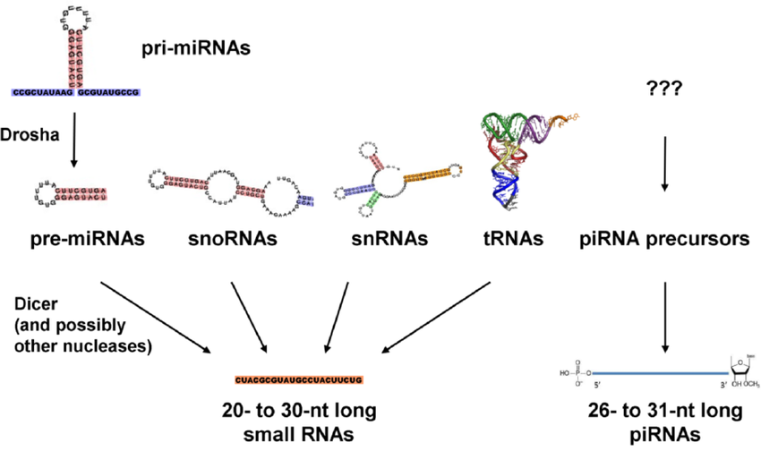
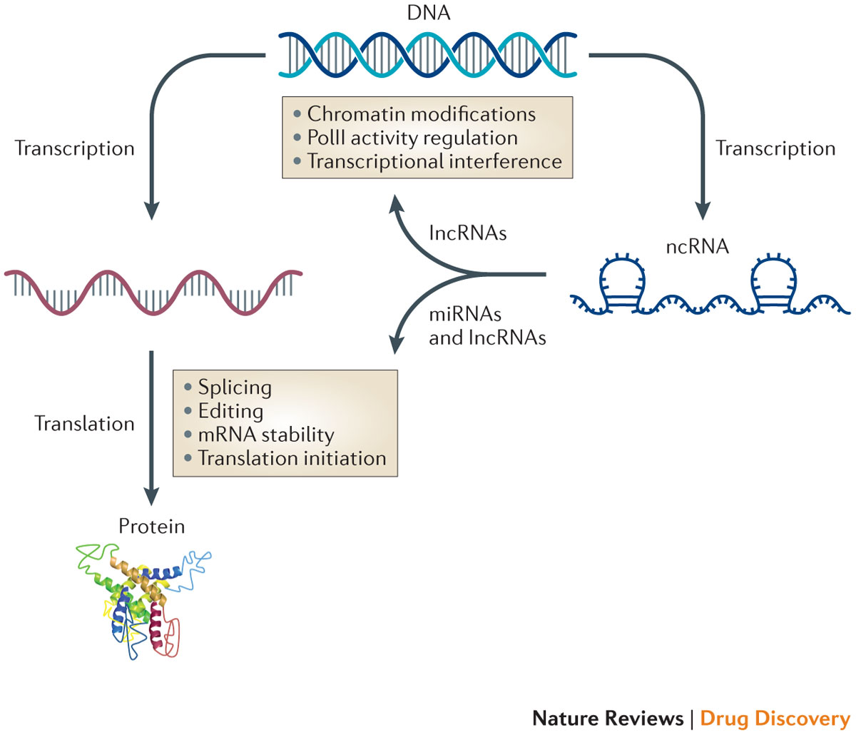
The Central Dogma of Molecular Biology
~ 80%
~2%
Protein
DNA
RNA
Replication
Transcription
Translation
microRNAs
Alternative spliced mRNAs
lncRNAs

Slide 6
Human Genome
Consists of ~3.3 billion basepairs
Total ~20,000 protein-coding genes
Whole-genome sequence equals ~825 Mb
Data storage requires Terabytes!
Sequence variation: repeats/deletions, SNPs…
Single Nucleotide Polymorphisms:
Specific nucleotides in the genome showing variation across the population in comparison to the reference sequence
Notes:
Effect sequence variation depends a lot on location in the genome; SNPs

Slide 7
Single Nucleotide Polymorphism
rs756599860
TGATGCCTTTGTTATCTACTCAAGACAGGATGAGGACTGGGTAAGGAATG (ref)
TGATGCCTTTGTTATCTACTCAAGCCAGGATGAGGACTGGGTAAGGAATG (alt)
Notes:
Effect sequence variation depends a lot on location in the genome; SNPs

Slide 8
AIMS of this lecture
Understanding genomic variation, SNPs
Functional relevant variation
Use of online databases

Slide 9
Functional variants
Single Nucleotide Polymorphisms (SNPs)
Intronic
Exonic
Promotor region
Regulatory elements
Notes:
Functional variant: genetic variation with effect on gene expression in any way (methylation, CNV, …).

Slide 10
Functional variants
Single Nucleotide Polymorphisms (SNPs)
Intronic
Exonic
Promotor region
Regulatory elements
Notes:
Functional variant: genetic variation with effect on gene expression in any way (methylation, CNV, …).

Slide 11
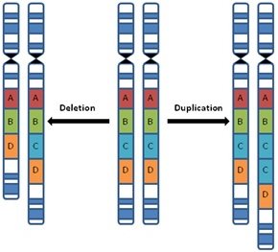
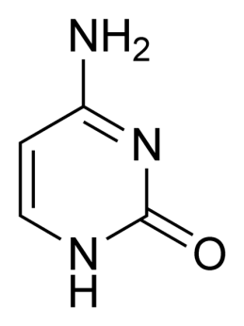
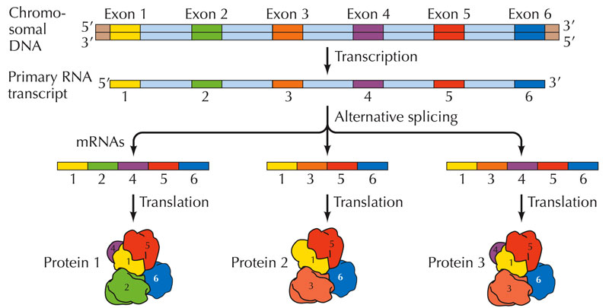
Functional variants
Single Nucleotide Polymorphisms (SNPs)
Methylation
Copy number variation (CNV)
Alternative splicing
DBP
Notes:
Functional variant: genetic variation with effect on gene expression in any way (methylation, CNV, …).

Slide 12
Intronic SNPs
A/C
*
*
A-variant
C-variant

Slide 13
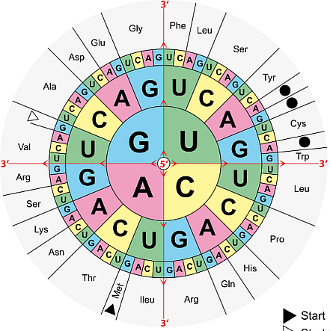
Exonic SNPs
Coding SNPs:
Synonymous or non-synonymous
Codon: G A A Glu
Codon: G A G Glu
Codon: G G A Gly
Codon: T A A STOP

Slide 14
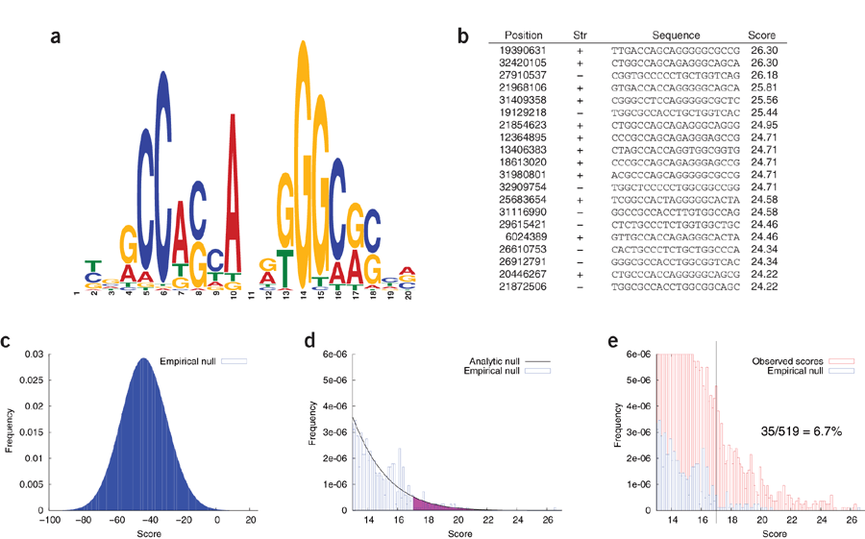
Promotor SNPs
Disruption of protein recognition sites

Slide 15
Promotor SNPs
TF
SNP G recognition
SNP A recognition
TF
G
DNA
Gene
RNA pol
RNA pol

Slide 16
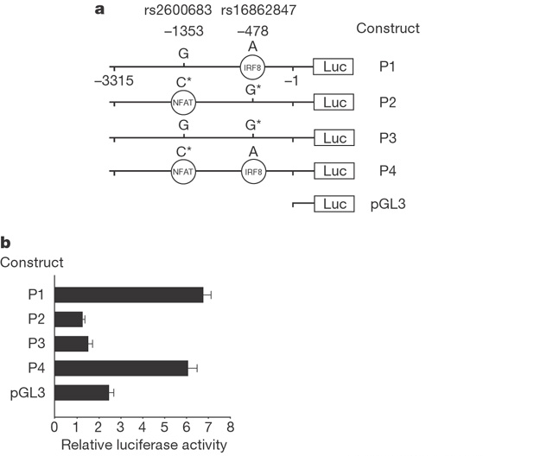
Promotor SNPs

Slide 17
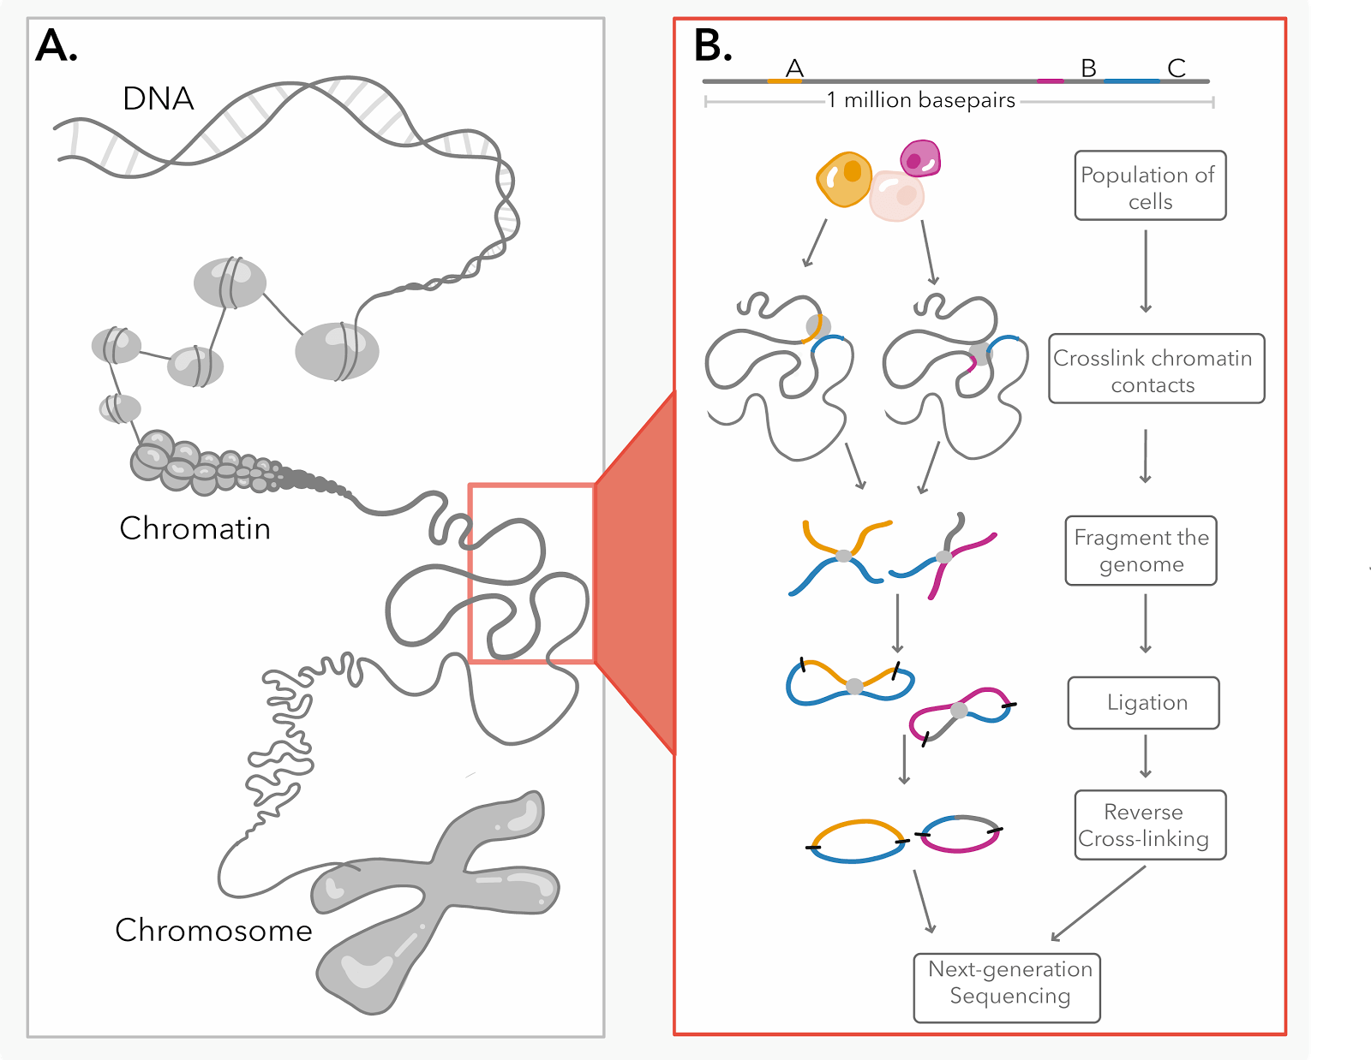
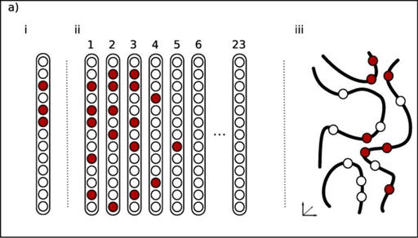
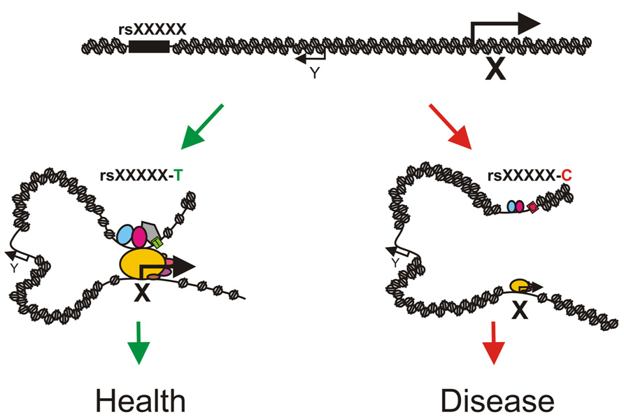
Distal regulatory elements
Thévenin et al 2014; doi: 10.1093/nar/gku667; Johnson 2018
Notes:
Distal regulatory elements: specifically challenging.

Slide 18
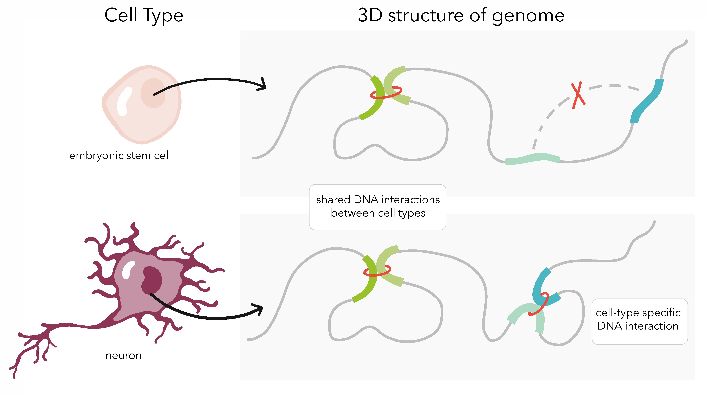
Distal regulatory elements
https://www.youtube.com/watch?v=1Fyq9ul9N9Q&feature=youtu.be
Johnson 2018
Notes:
Distal regulatory elements: specifically challenging.

Slide 19
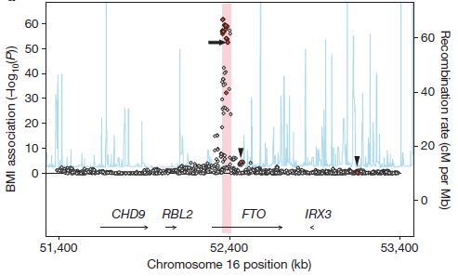
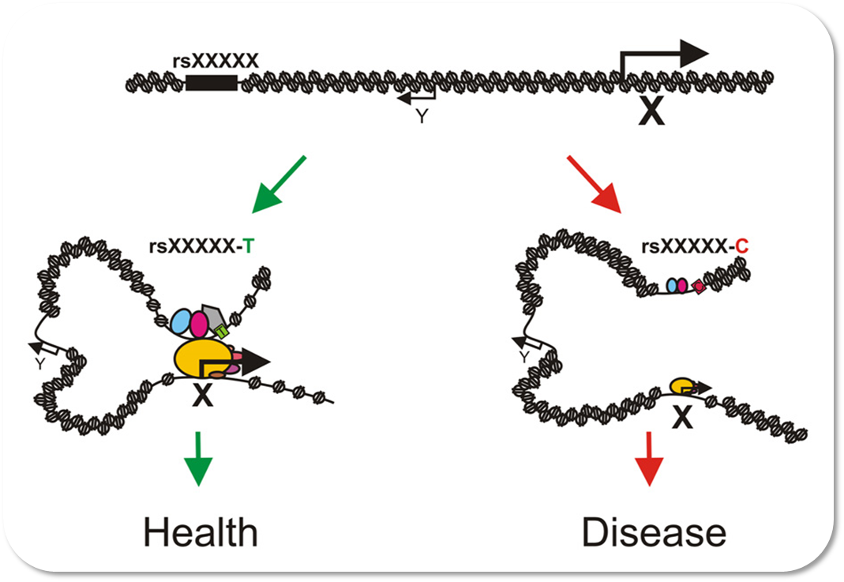
Distal regulatory elements
Smemo et al 2014, doi:10.1038/nature13138; Rask-Andersen et al 2015, doi:10.1007/s00439-015-1599-5
Notes:
Distal regulatory elements: specifically challenging.

Slide 20
Summary – disease relevant SNPs
Functional SNPs
Codon change
Alternative splicing
Variation in regulatory elements
Promotor
Distal regulatory element

Slide 21
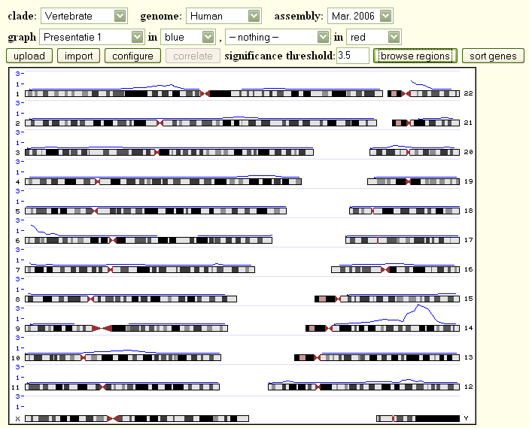
Example case – Genome Graphs

Slide 22
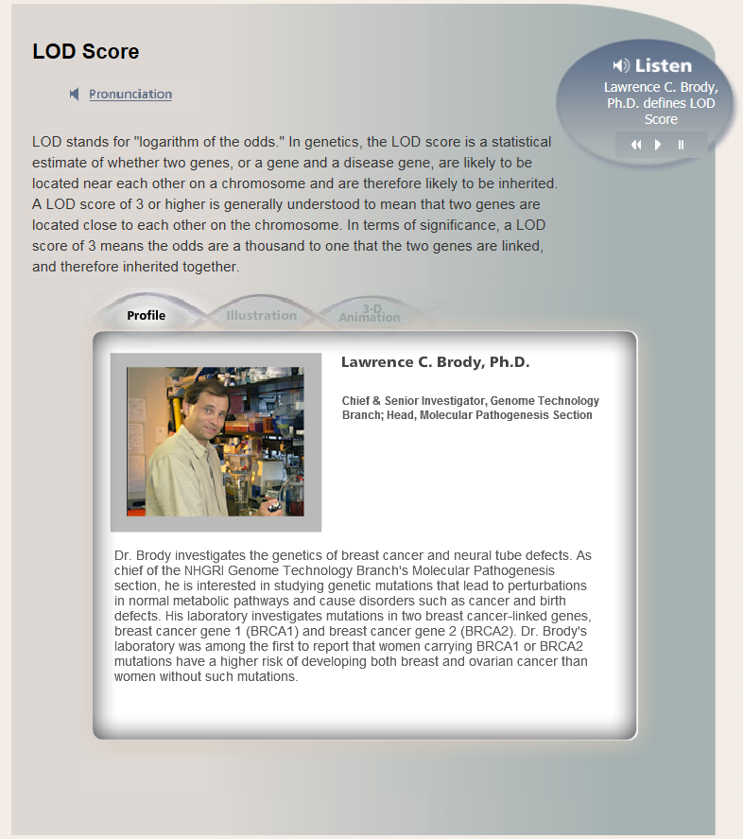
Example case - Linkage Datafile
LOD score:
logarithm (log10) of the odds;
for LOD=3 the odds is 10³ (1000) to 1 that the genomic region is linked with trait tested.
https://www.genome.gov/glossary/index.cfm?id=531
Notes:
1) Not all variants are present in all populations
Ernst van phenotype geeft indicatie over wat je verwacht aan SNP-effect.

Slide 23
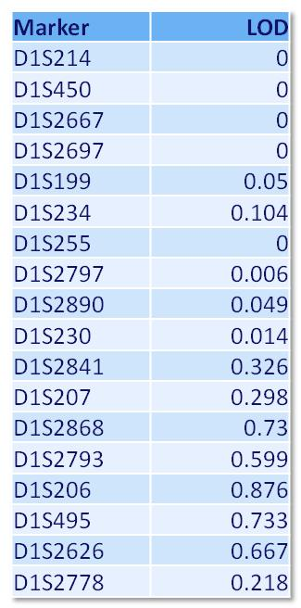
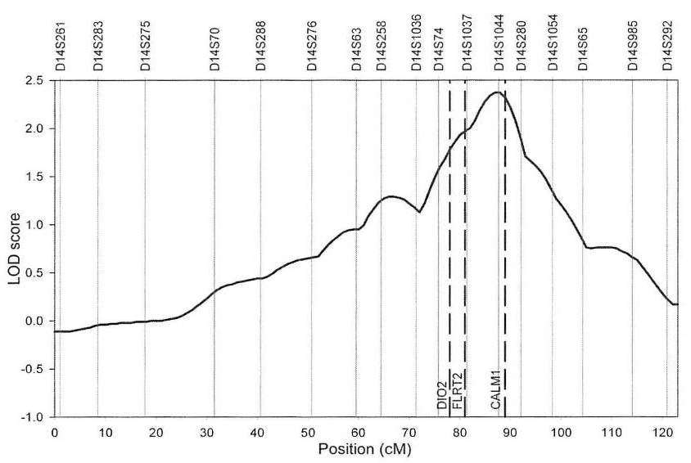
Example case - Linkage Datafile
Linkage at chromosome 14q32.11
3 genes within 1-LOD drop interval
DIO2
FLTR2
CALM1
Meulenbelt et al 2008, doi:10.1093/hmg/ddn082

Slide 24
Summary – disease relevant SNPs
Functional SNPs
Alternative splicing
Codon change
Variation in regulatory elements
Promotor
Distal regulatory element

Slide 25
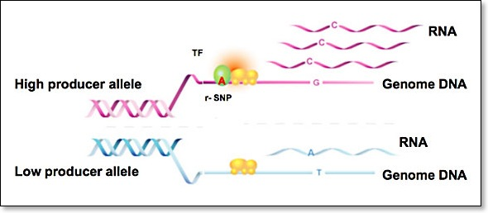
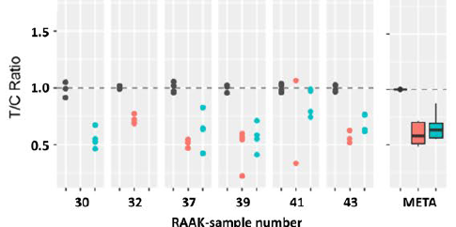
Allelic Imbalanced Expression

Slide 26
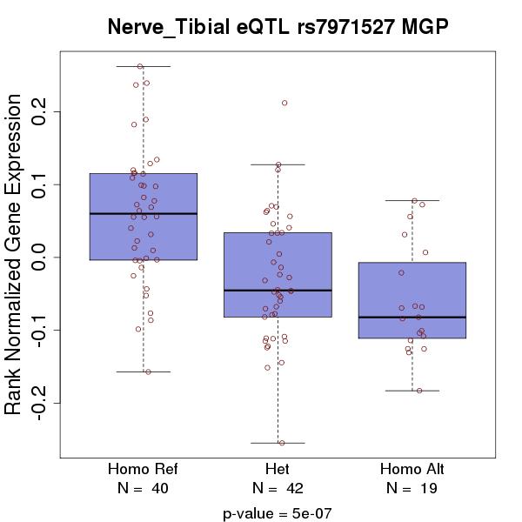
eQTLs – Genevar & GTEx
Expression Quantitative Trait Locus
SNP affects gene expression
Either in cis or in trans
Notes:
For some reason Genevar did not work this week, however it is a fairly straightforward tools that uses genome wide SNP data in combination with microarray expression data.

Slide 27
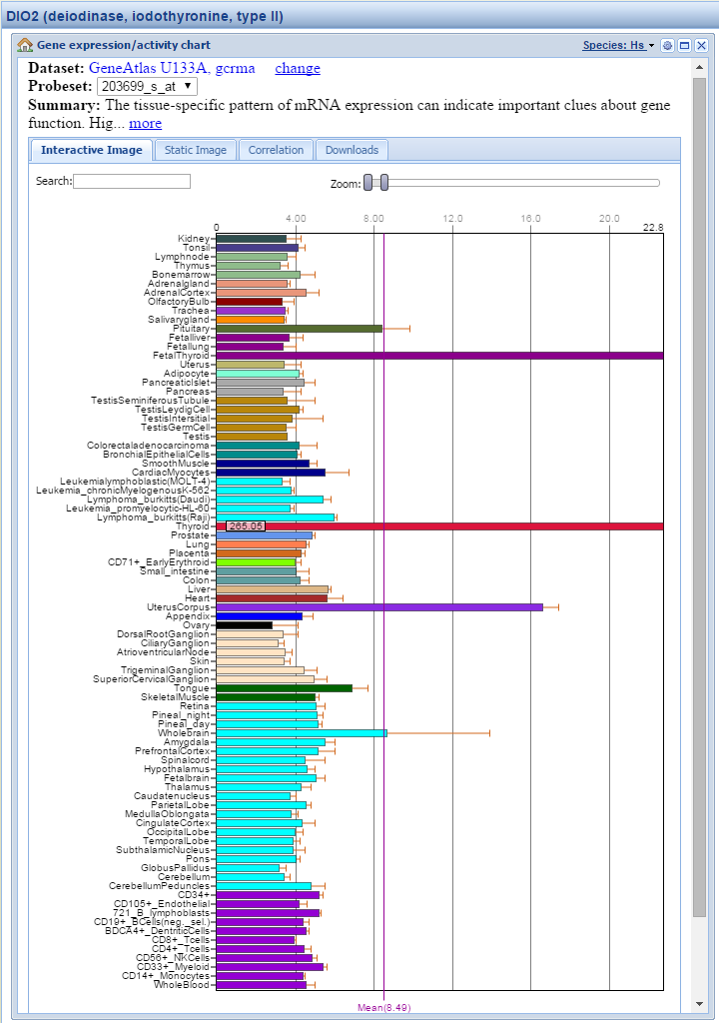
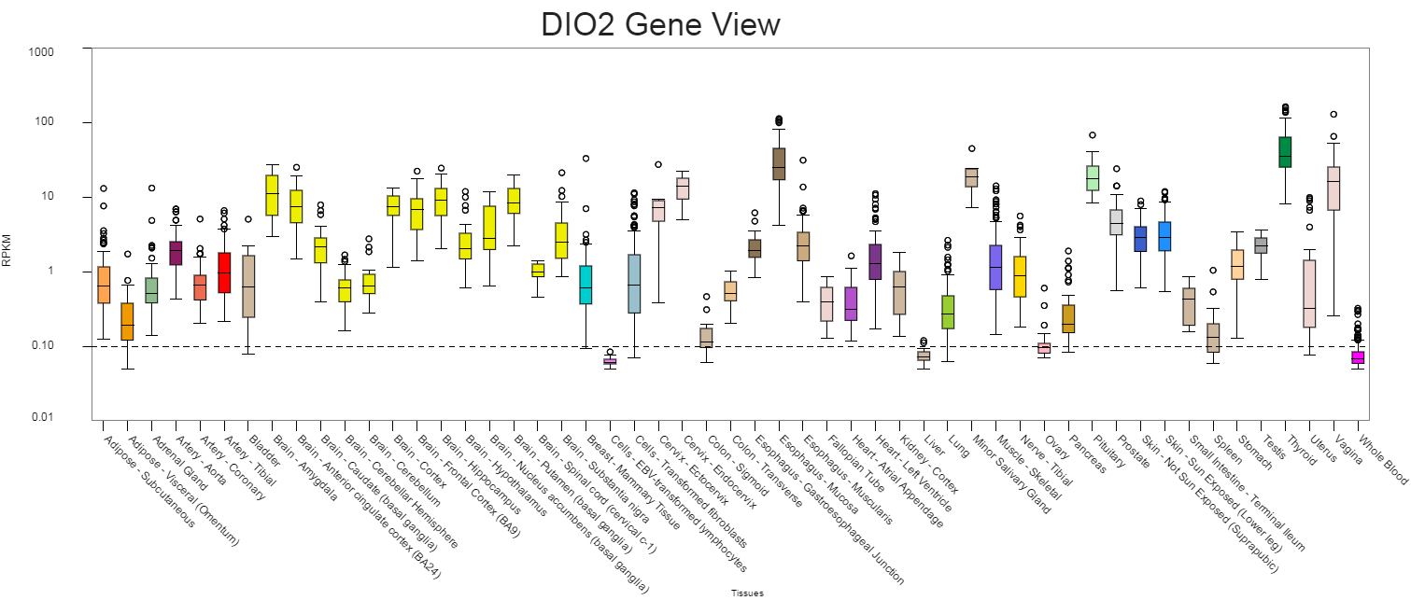
Expression – Tissue of Interest (BioGPS & GTEx)

Slide 28
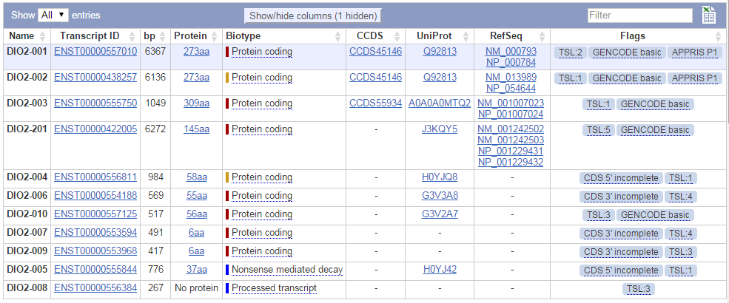
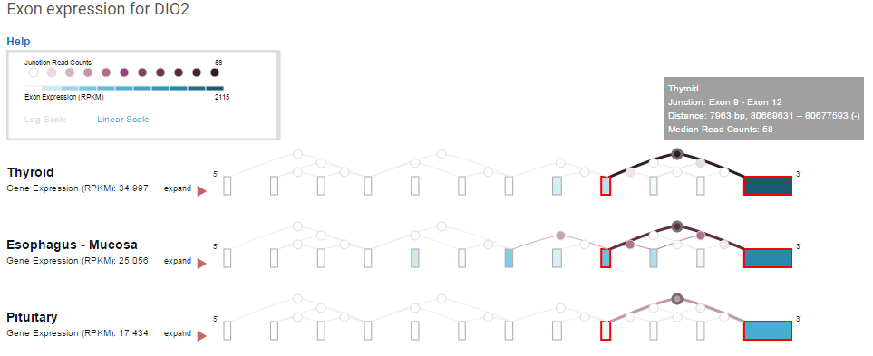
Expression – Alternative splicing
Ensembl gives an overview of reported splice variants
GTEx shows tissue specific splice information

Slide 29
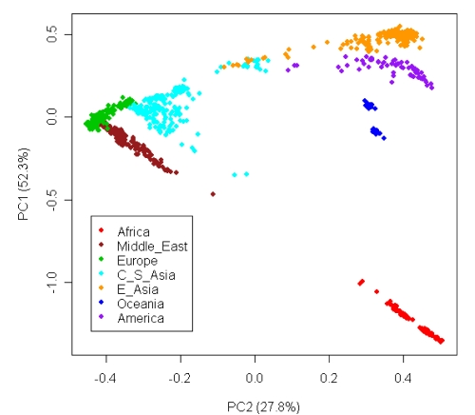
Criteria relevant SNPs
Functional relevant variant
Polymorphic in specific population
Tagging SNP (possibly: tagging functional SNP)
Assay design possible (repeat, GC-rich)
Li et al 2008, doi:10.1126/science.1153717
Notes:
A tag SNP is a representative single nucleotide polymorphism (SNP) in a region of the genome with high linkage disequilibrium that represents a group of SNPs called a haplotype. It is possible to identify genetic variation and association to phenotypes without genotyping every SNP in a chromosomal region

Slide 30
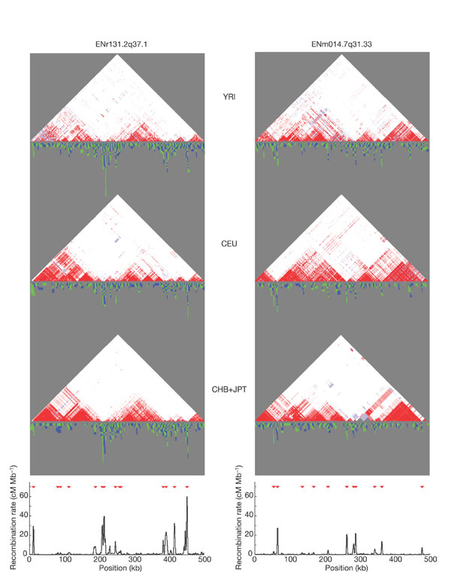
Tagging SNP
Linkage across ‘blocks’: genetic variation is limited
(several SNPs carry same information)
Notes:
A tag SNP is a representative single nucleotide polymorphism (SNP) in a region of the genome with high linkage disequilibrium that represents a group of SNPs called a haplotype. It is possible to identify genetic variation and association to phenotypes without genotyping every SNP in a chromosomal region

Slide 31
Tagging SNP
rs756599860
rs779420060
TGATGCCTTTGTTATCTACTCAAGACAGGATGAGGACTGGGTAAGGAATG (ref)
TGATGCCTTTGTTATCTACTCAAGACAGGATGAGGACTGGGTAAGGAATG (ref)
TGATGCCTTTGTTATCTACTCAAGCCAGGATGAGGACTGGGTAAGGAATG (alt)
TGATGCCTTTGTTATCTACTCAAGCCAGGATGAGGACCGGGTAAGGAATG (alt)
Notes:
Effect sequence variation depends a lot on location in the genome; SNPs

Slide 32
AIMS of this lecture
Understanding genomic variation, SNPs
Functional relevant variation
Use of online databases

Slide 33
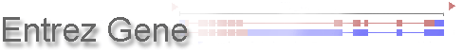
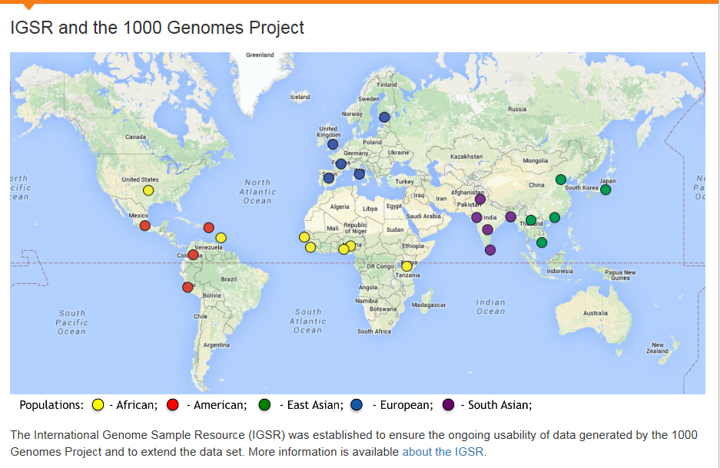
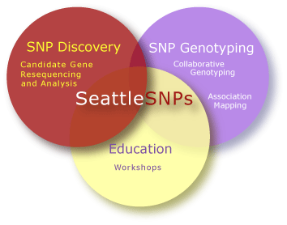
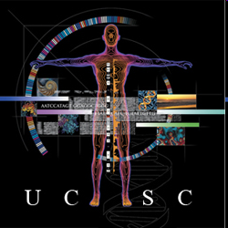

Human Genome
Consists of ~3.3 billion basepairs
Whole-genome sequence equals ~825 Mb
Data storage requires Terabytes!
Online databases contain information on thousands of individuals and millions of polymorphisms

Slide 34
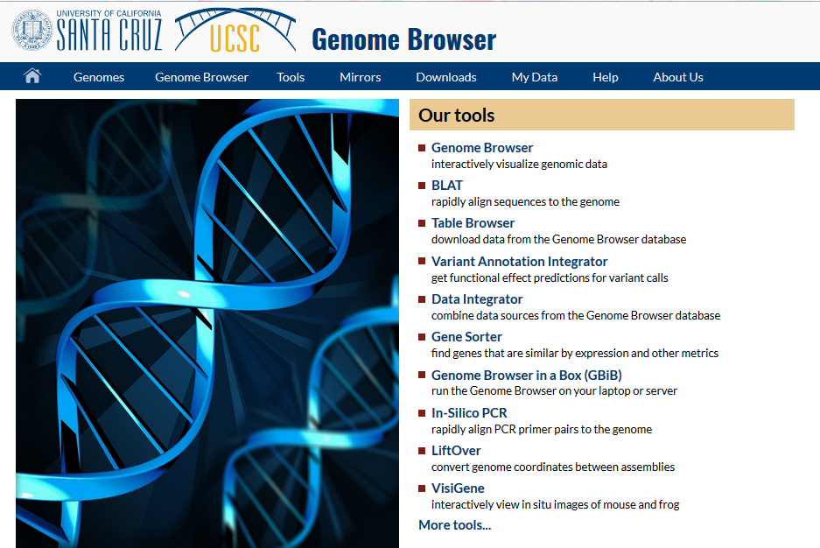
Example case – UCSC Genome Browser

Slide 35
Surplus of information
Filter information by:
Population of interest (CEU, CHB+JPT, etc.)
Chromosome / locus
Gene
Intronic / Exonic / Promotor / 5’ UTR/…
Basepair
(Some) criteria for disease relevant SNPs:
If exonic: non-synonymous; damaging?
If not: in regulatory element?
Notes:
1) Not all variants are present in all populations

Slide 36
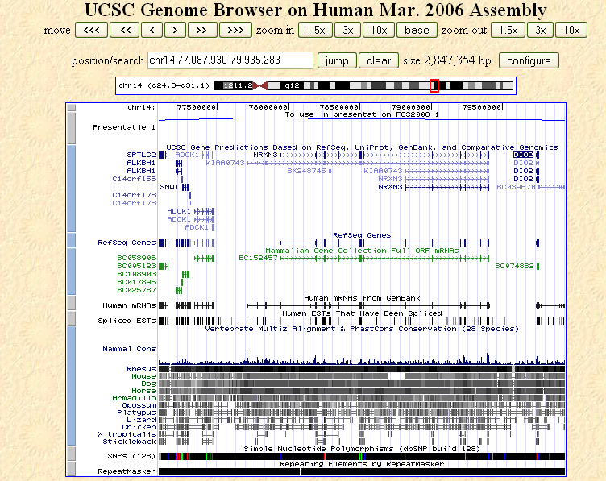
Example case - Genome Browser

Slide 37
Example case - Genome Graphs

Slide 38
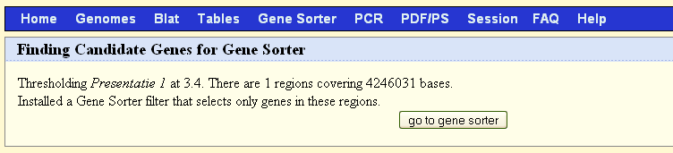
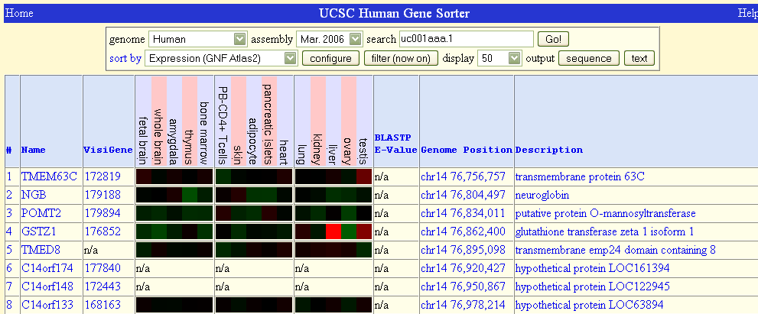
Example - Gene sorter

Slide 39
Description and known literature
Gene function NCBI / OMIM
Literature PubMed
Expression
eQTLs Genevar / GTEx
Tissue of interest BioGPS / GTEx
Alternative splicing Ensembl / GTEx
Known genetic variation UCSC / HaploReg / SNPper

Slide 40
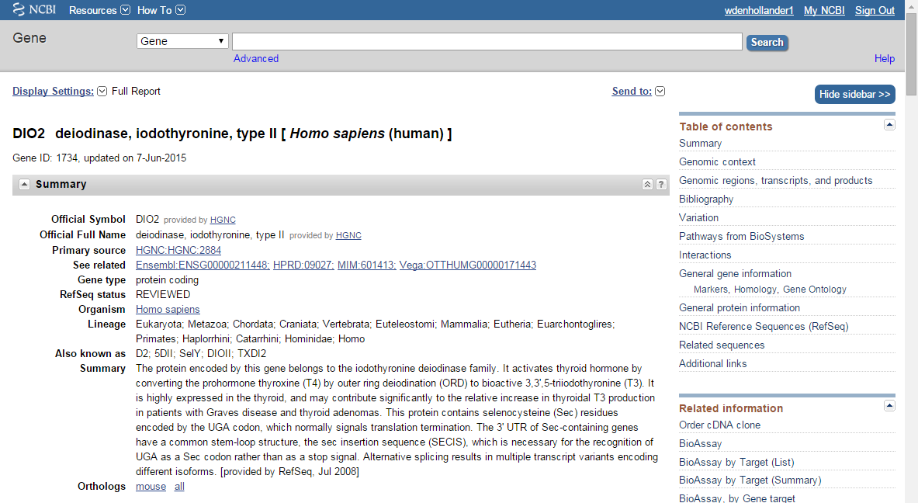
NCBI – Entrez Gene
GeneRIFs!
Gene Reference into Function

Slide 41
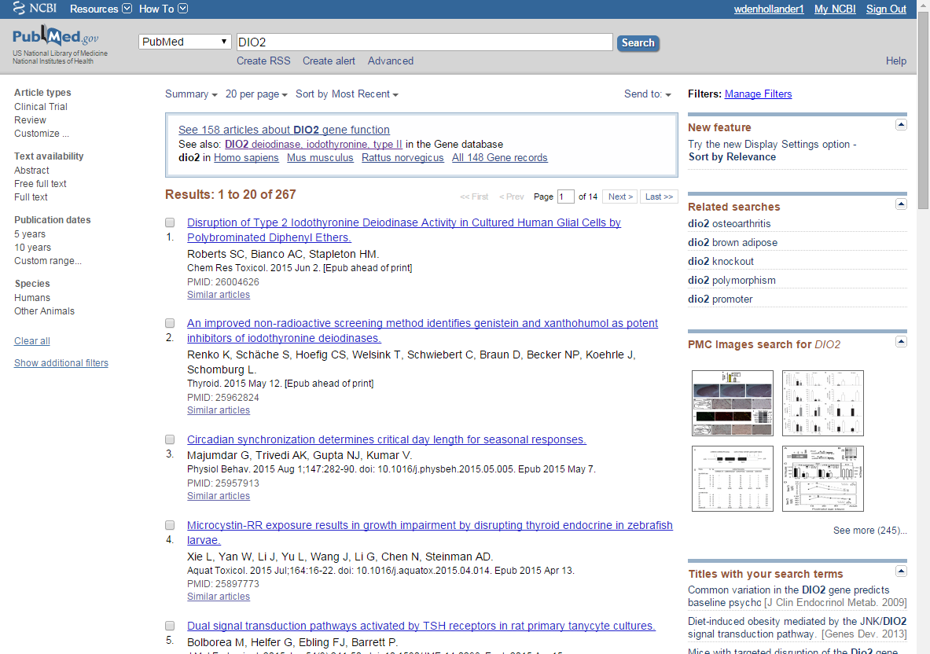
Literature - PubMed

Slide 42
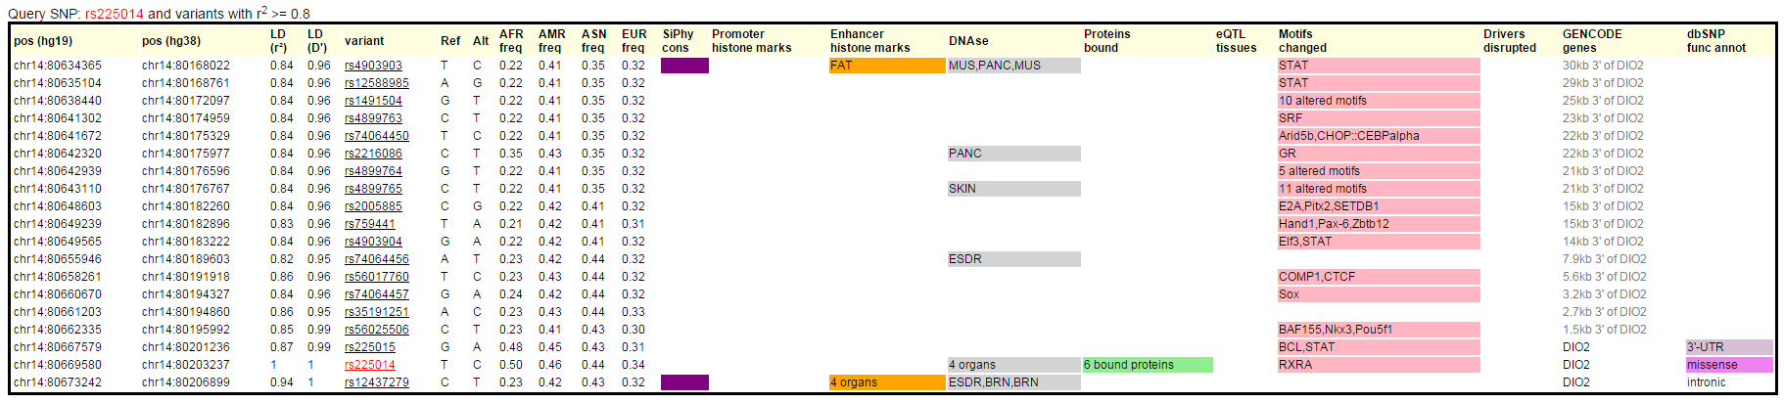
Known genetic variation - HaploREG
SNPs in LD
Alleles
Population frequencies
Protein binding
DNAse sensitivity
…

Slide 43
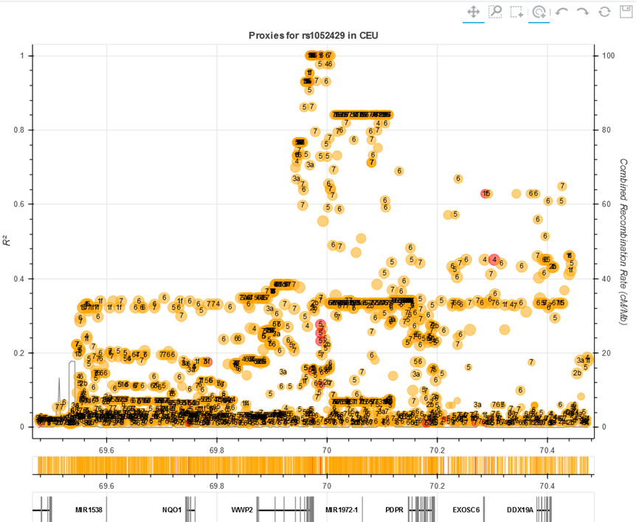
Known genetic variation - LDlink
No direct information mRNA or protein consequences
Focussed on regional variation
Submit (list of) SNPs

Slide 44
Subsequent steps
Check for redundancy (LD):
Ldlink, HaploReg
Design assay
If unsuccessful, use alternative SNPs (based on LD)
Measure SNPs
Determine functionality: wet lab!

Slide 45
Questions
QUESTIONS?

Slide 46
Finding genes in practice
Yolande F. M. Ramos
y.f.m.ramos@lumc.nl
Molecular Epidemiology
Leiden, the Netherlands

Slide 47
AIMS of this practical session
AIMS of this practical session
Understanding genomic variation, SNPs
Functional relevant variation
Use of online databases

Slide 48
Questions & Excercise
Databases; hands on experience
Select your own dataset (Data_x) and follow manual
Share tips & tricks
Sometimes the web-based tools are a bit messy
Ask questions!

Slide 49
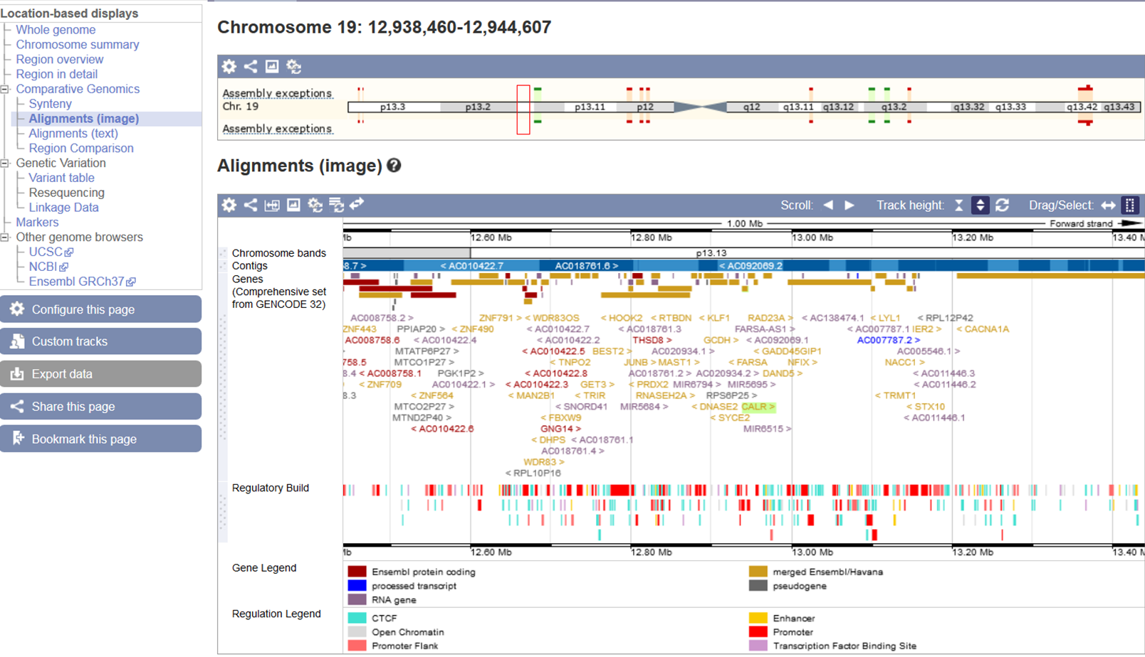
Ensemble – an example
Ensemble – an example

Slide 50
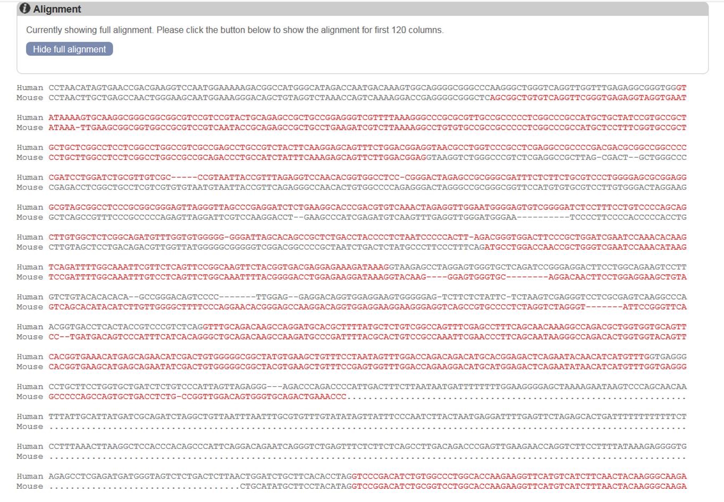
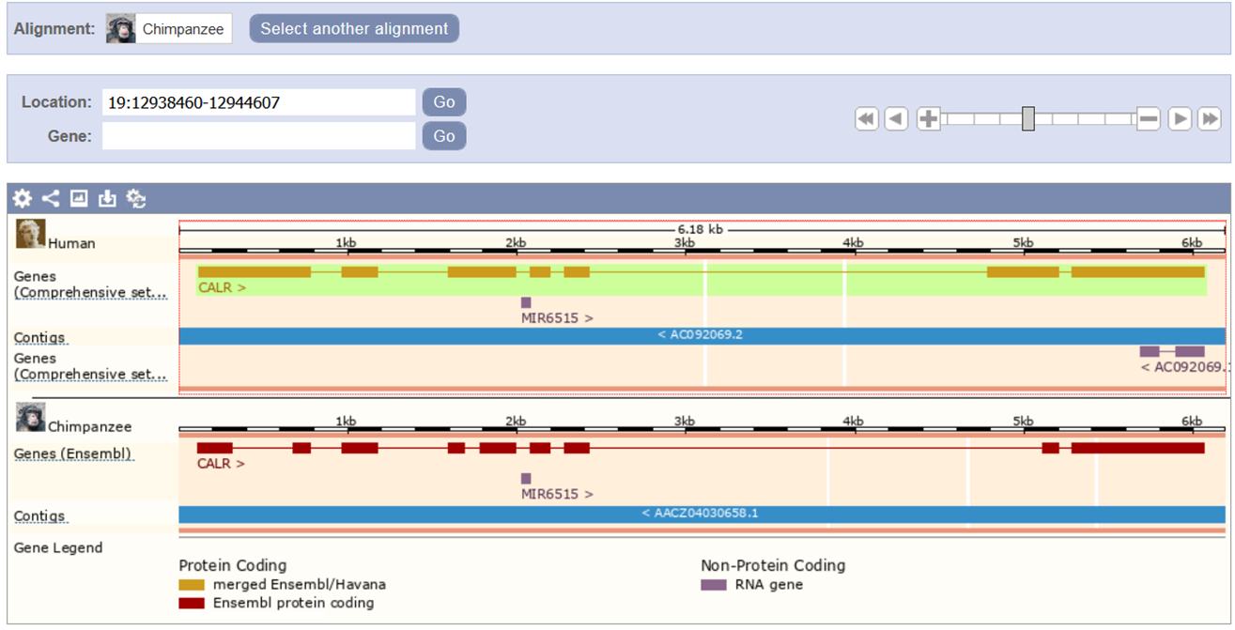
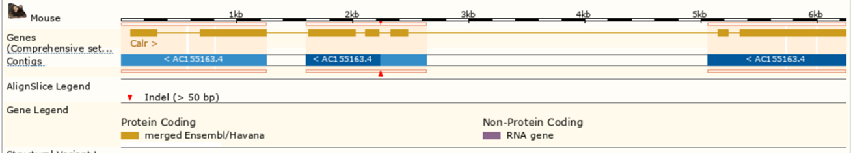
Ensemble – an example
Ensemble – an example
TEXT
IMAGE

Slide 51
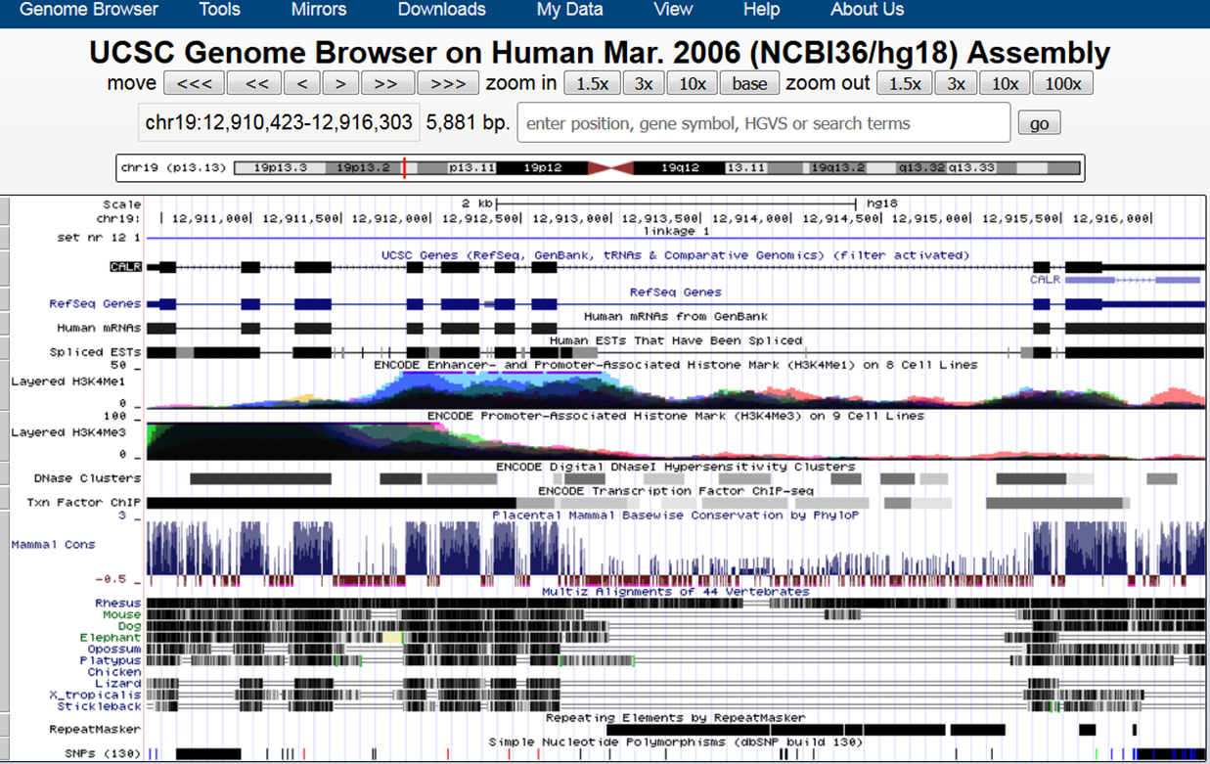
UCSC – an example
UCSC – an example

Slide 52
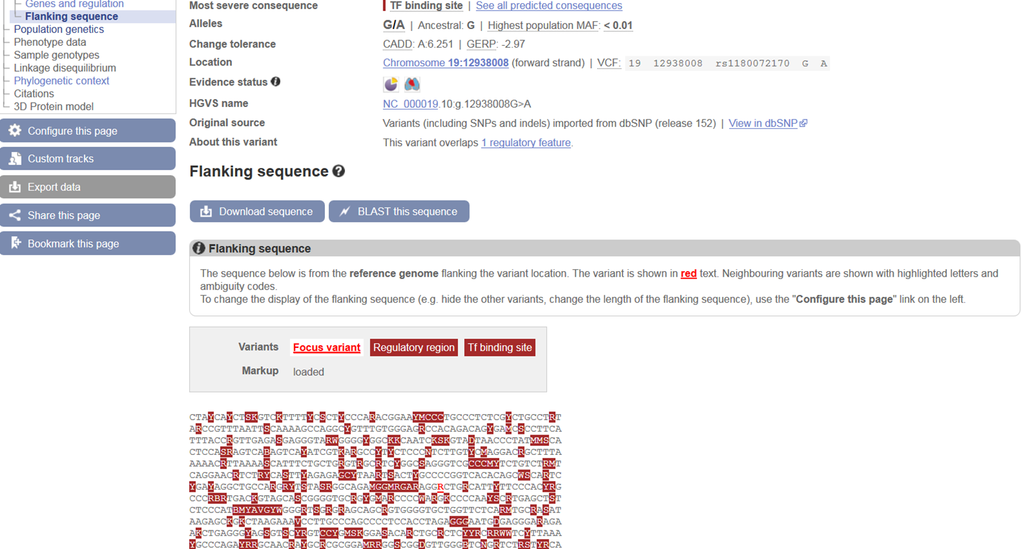
Ensemble – an example
Ensemble – an example
rs1180072170 SNP

Slide 53
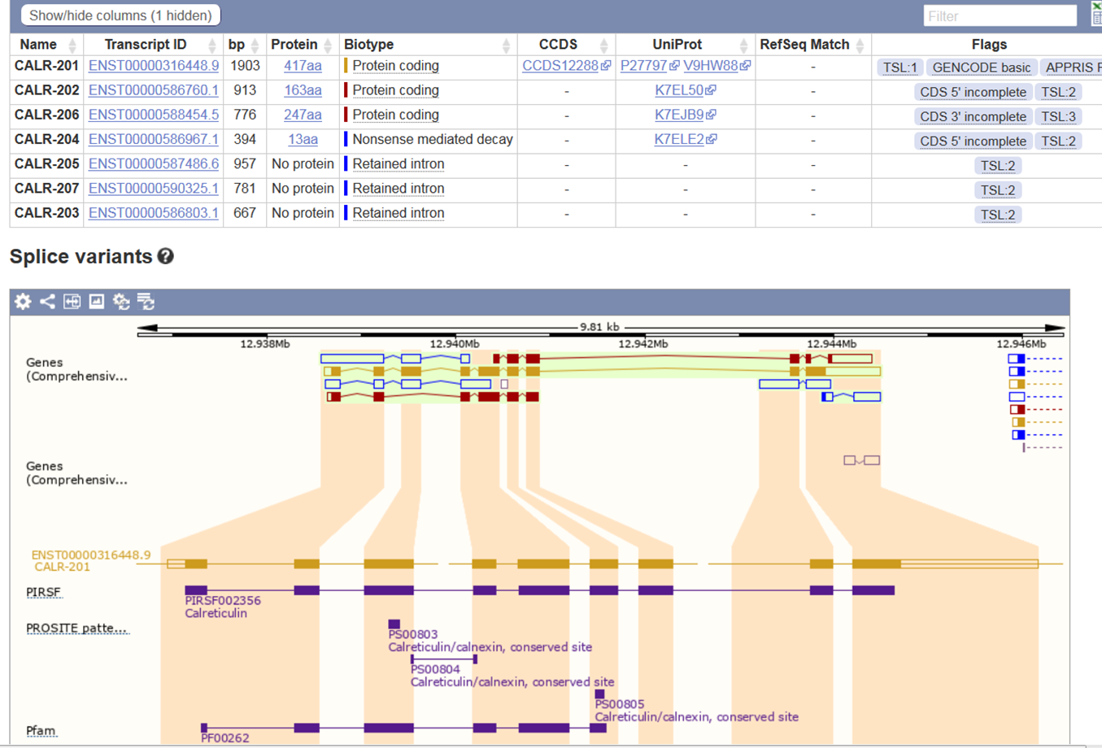
Ensemble – an example
Ensemble – an example

Slide 54
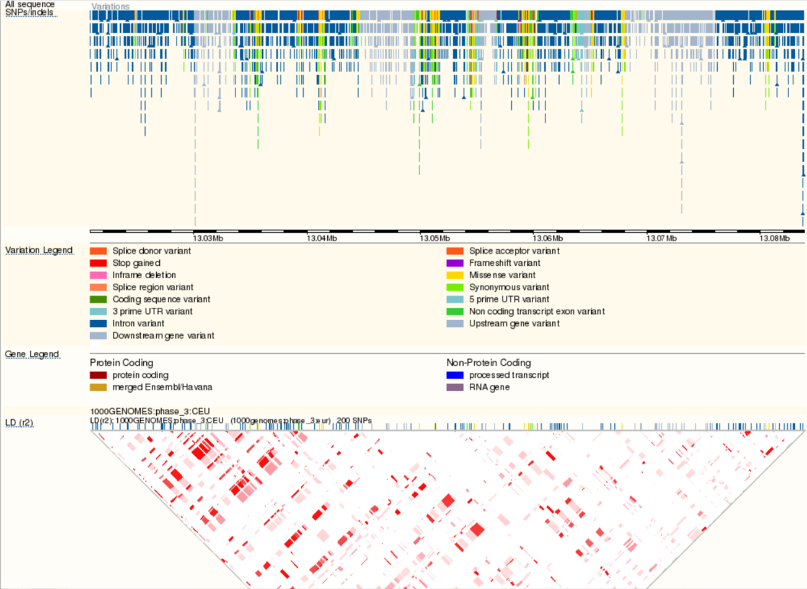
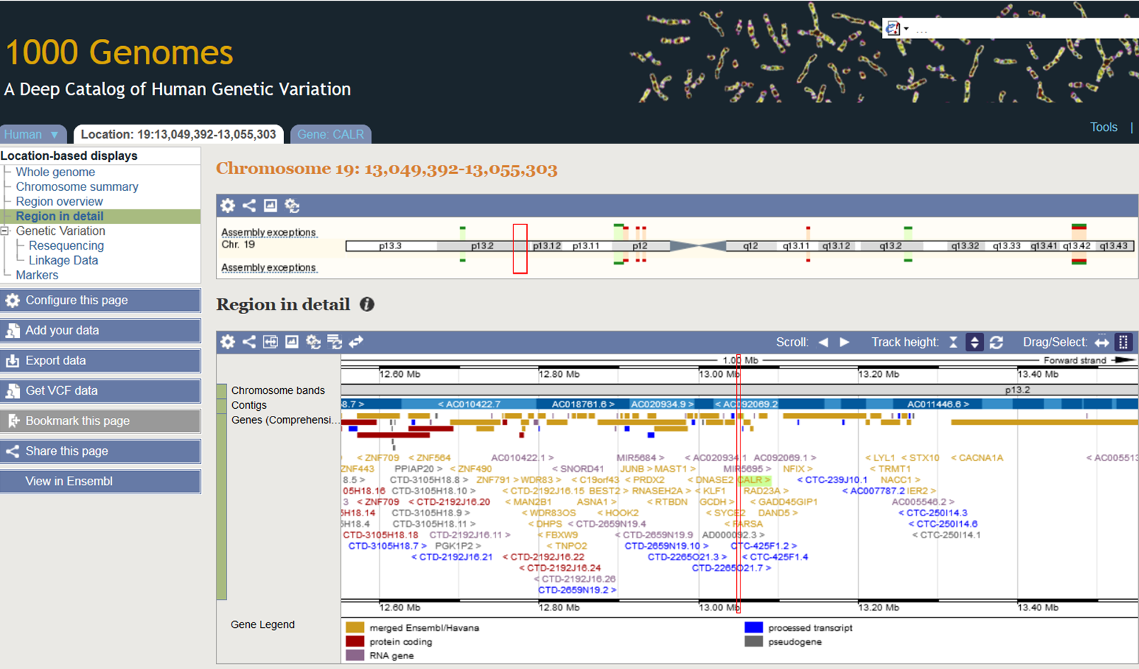
1000 Genome – an example
1000 Genome – an example

Slide 55

Ensemble – an example
1000 Genome – an example
rs191183059

Slide 56

HaploReg – an example
1000 Genome – an example

Slide 57
Explore
SNP Nexus – an example
Gene: WWP2
SNP: rs1052429
https://pt.coursera.org/lecture/disease-genes/identifying-causative-genes-integration-of-the-genomic-data-6jOLf
https://www.labroots.com/trending/cell-and-molecular-biology/5499/impact-neanderthal-dna-human-gene-expression
Notes:
https://snp-nexus.org/test/snpnexus_44819/results.html

